Slide 1

climeCHANGE Mumbai,India
Team Members
Nitesh Idnani
Rudra Mishra
Rohan Sewaney
Rohan Purswani
Rohit Dayani
Errol Fernandes
No NGOs and partners involved

Slide 2
Name : Public Awareness
Challenge statement:
How might we increase overall understanding of the science and facts of climate change, to gain a critical mass of public awareness and support for strong action on climate change?

Slide 3
Solution :
The solution is pretty simple, but it makes a huge difference if everyone tries to follow it. Yes, public awareness is the key , though most of the people know what to do but don’t know how to do it. The website, highlights the importance of individual effort.

Slide 4
Progress :
We have created the website (climechange.com) which lays emphasis on the following:
Causes:
The causes of climate change are largely unknown. Most people blame industries in general. The causes make us aware that it is our personal actions that causes climate change.
Effects:
Everyone knows the effects of climate change. But a personal approach this is lacking. The general idea is that climate change affects others, not me. We seek to change this idea.
Control Measures:
This part highlights individual contribution with respect to controlling climate change. It emphasizes that individual effort is mandatory. Every drop in the ocean counts.

Slide 5
What next?
Yes we are all willing to take forward this initiative and do further research on climate change and make people more aware of the changes happening so that in near future our world becomes a better place to live.
Twitter handle :
@rohanpurswani

Slide 6
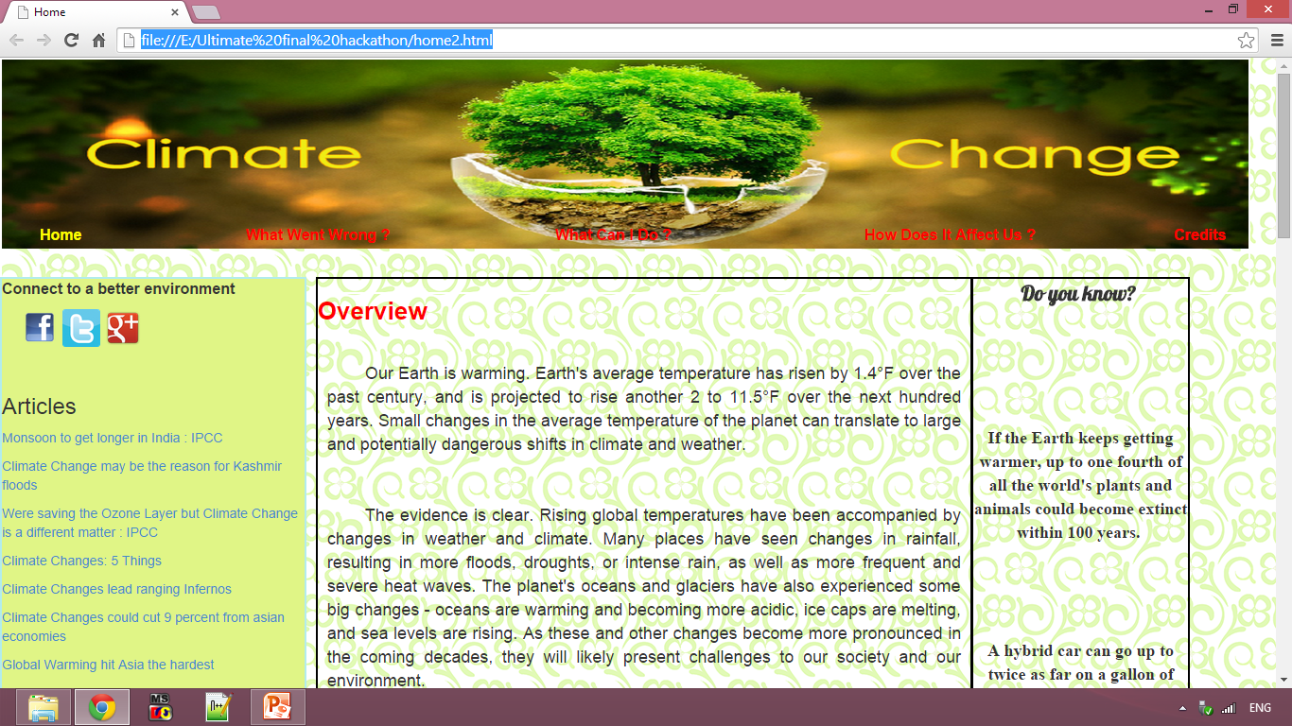
Glimpses :

Slide 7
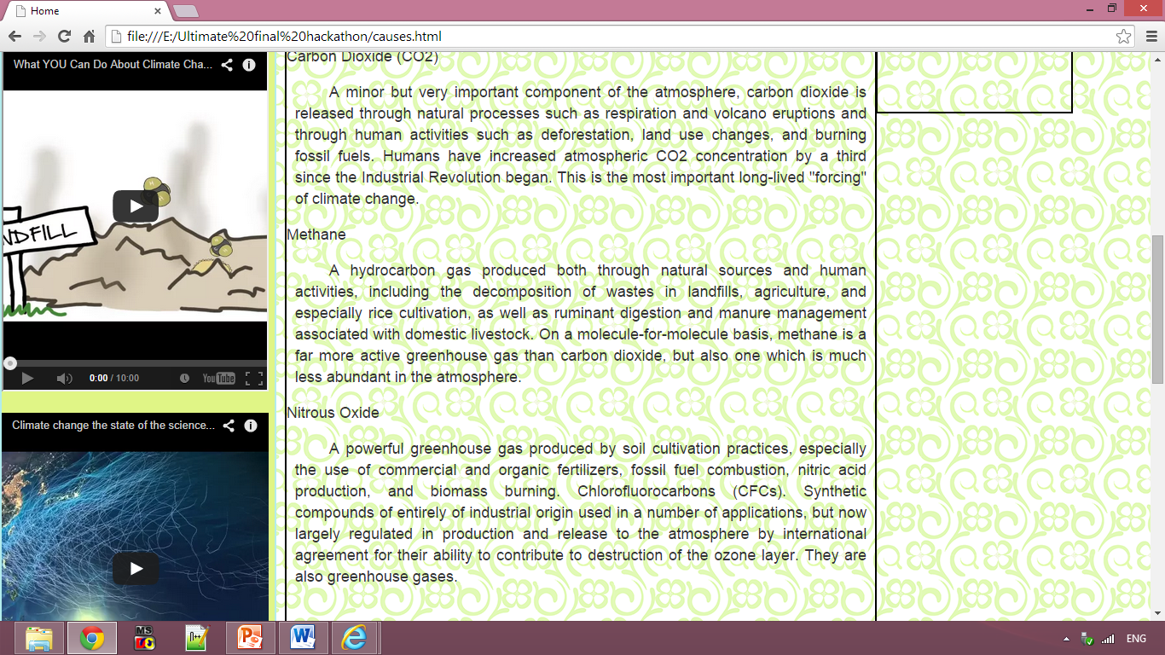
Glimpses

Slide 8
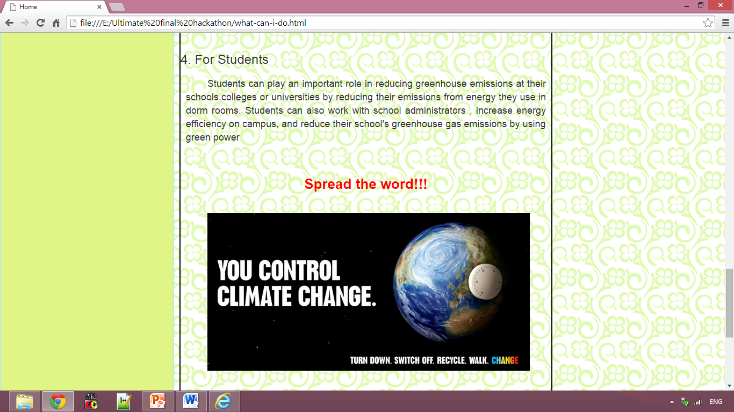
Glimpses

Slide 9
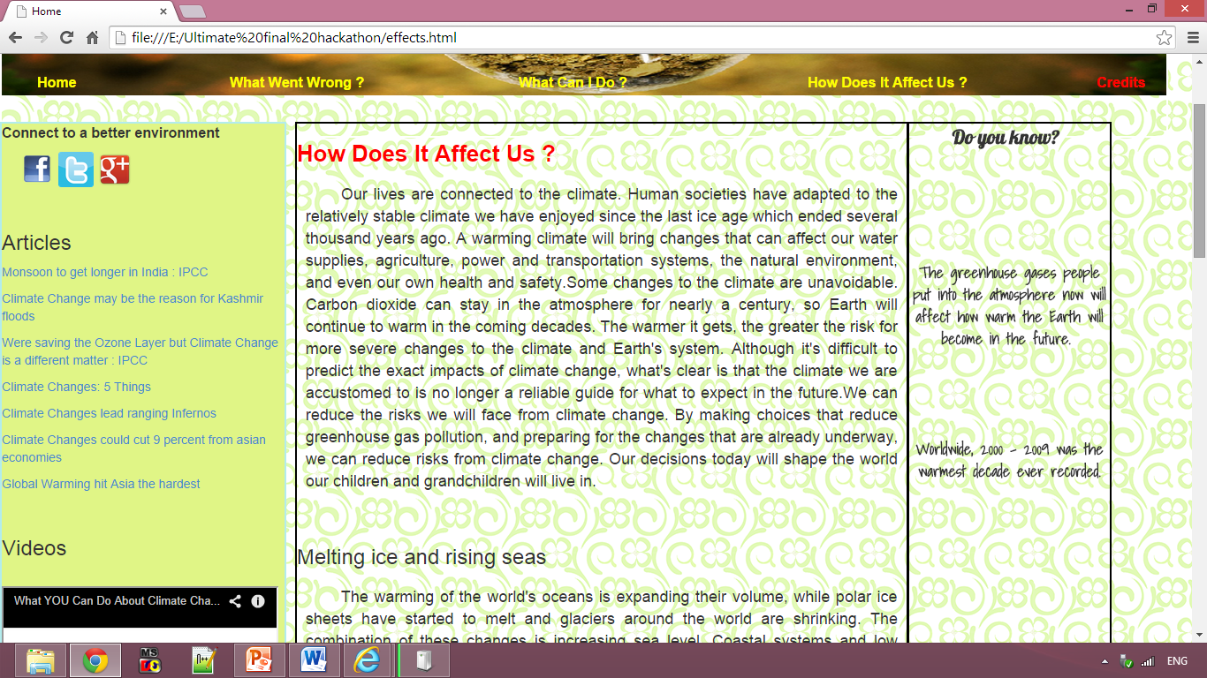
Glimpses

